Slide 1


Police and Health Operational Staff Perspectives on managing detainees held under Section 136 of the Mental Health Act: A Qualitative Study in London
Arun Sondhi and Emma Williams
Notes:
Need to explain focus of the paper is about the risk aspects…. And differing notions of ‘risk’ for the police and the HC professionals then slide 2 – current context and research evidence….

Slide 2
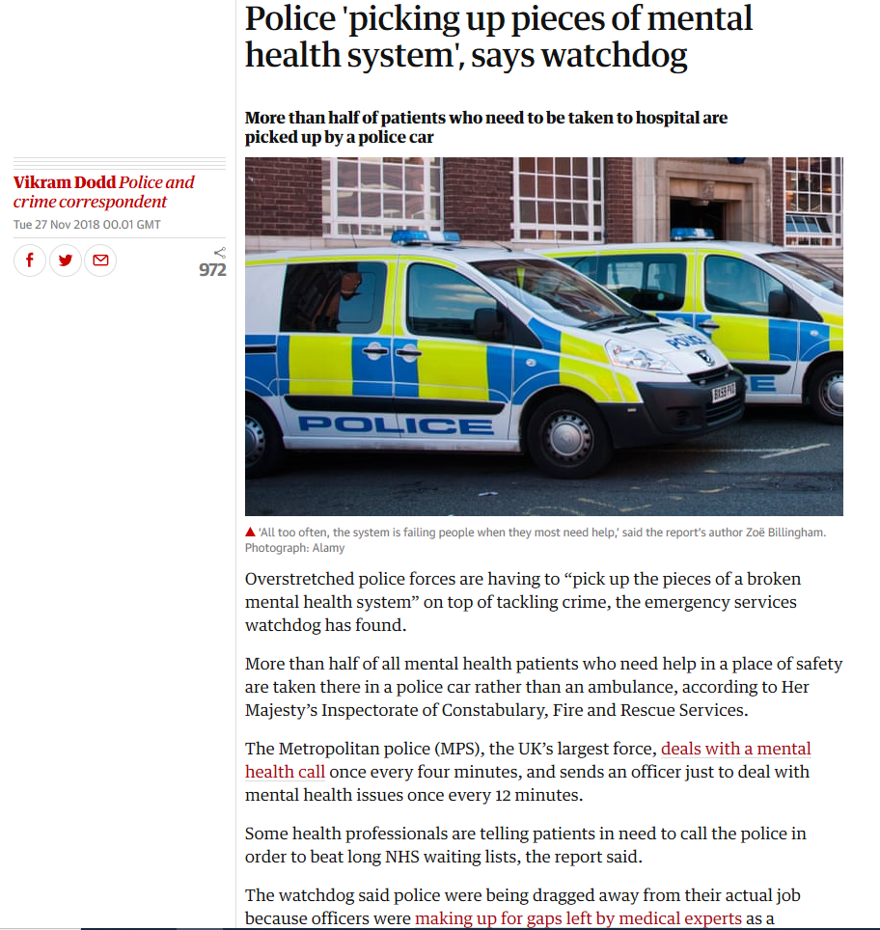
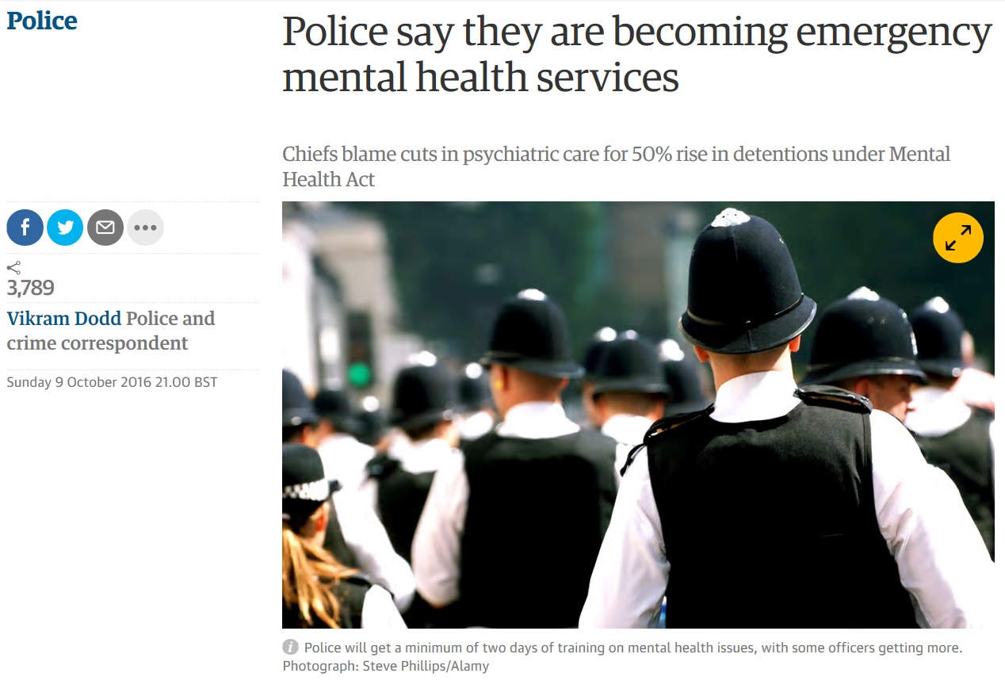
In the News…

Slide 3
What is Section 136?
Requirement under 1983 Mental Health Act amended by the Policing and Crime Act, 2017
Person “suffering from a mental disorder” detained “in the interests of that person or for the protection of other persons”
Within a “public place” only
Person taken to a “place of safety” – Mental Health hospital or Emergency Department for assessment (no longer police stations)

Slide 4
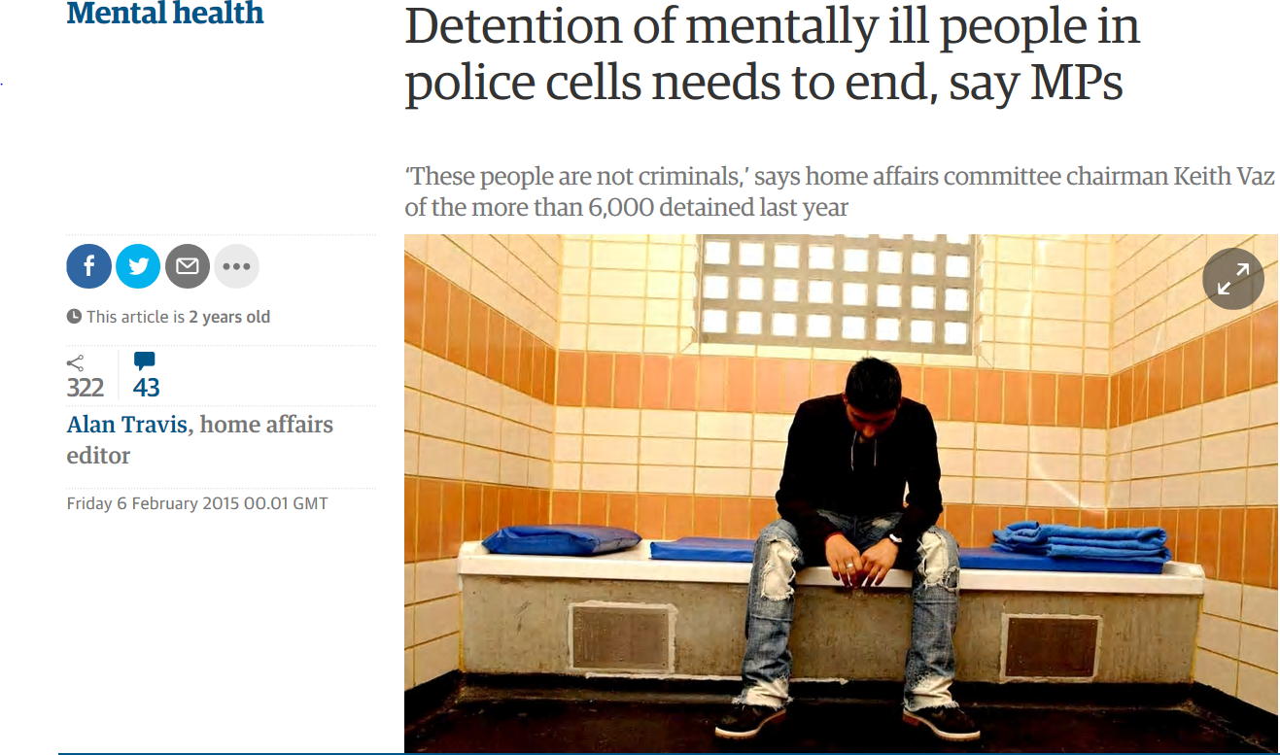
Controversies
Lack of police awareness of mental health; issues with operational practice
Police custody and Emergency Departments inappropriate
People turned away and waiting too long
Quality of mental health treatment (CQC inspections)

Slide 5
Study Aims/Method
Probe interface between police and health/social services to derive emergent themes
196 in-depth interviews with police and health/social services involved in the detention, conveyance, assessment and treatment of detainees
Interviews analysed using ‘Framework’ method (Ritchie & Lewis, 2003) to identify themes
Findings tested and refined by Delphi group of professionals (police, mental health)

Slide 6
Background to the Study: London
National Crisis Care Concordat (2014) aimed to create ‘whole system’ integrated approach
BUT…in London it takes 2 hours to convey a person to an NHS place of safety
Multiple points in the S136 process with up to 10 separate organisations involved
Notes:
So why London …

Slide 9
Detainee Perspectives
The detention process ‘frames’ the detainee response to treatment
Detention process is one episode, but have fragmentary recall
Detainees confused/angry over time to access services
Multiple assessment points that are ‘cold’ and ‘clinical’
Importance of therapeutic interactions by ALL actors during the detention process (Sondhi et al, 2018)

Slide 10
‘Defensive’ Risk (Reuveni et al, 2017; Studdert et al, 2005)
‘Assurance behaviours’ & ‘Positive defensive medicine’
Risk to detainee (self-harm/suicide)
NHS staff (violence)
Public (violence)
Organisational risk (reputational)

Slide 11
Risk Factors
Risk Factor | Issue | Issue | Response for Police
Clinical misdiagnosis | “Medically cleared” | Some symptoms similar to physical conditions e.g. head trauma/ Parkinson’s | Refused entry Police take detainee to acute services ‘Dead time’
Drugs and alcohol | Criteria for admission “Medically cleared” Withdrawal Overdose threat | Cannot be admitted if intoxicated Masks other conditions Acute withdrawal require specialists Interactions with medications Uncertainty new drugs trends (‘spice’, ‘party drugs’) | Refused entry Police take detainee to acute services ‘Dead time’

Slide 12
Risk Factors
Risk Factor | Issue | Issue | Response for Police
Staff Safety | Aggressive, violent, uncooperative behaviours | Violence to staff | Refused entry Police ‘manage’ detainee
NHS culture ‘procedures’ | Follow ‘rules driven’ approaches | Staff safety Misdiagnosis Risk to career if process not followed | Tension between police and health perceptions of detainee need and what is an appropriate response
NHS Staffing | Reliance on agency staff Ward staff transferred to S136 suite Attitudes to some detainees (e.g. drug users) | Uncertain how to manage detainees Default to rules and procedures Detainees more likely to disengage Detainees stigmatised | Police manage ‘difficult’ patients Manage AWOL

Slide 13
‘Defensive’ Risk: Health
Drugs and Alcohol
“We’ve done a breathalyser and they’re actually two and half times over the legal limit. We then say good, actually we’re not going to come out, give us a call back in two hours. What’s the point of going out to undertake an assessment for somebody who’s completely bladdered.”
(Approved Mental Health Professional)
Notes:
Across the entire system especially where junior staff e.g. SHOs are involved. Concern over managing medicines note poly-pharmacy

Slide 14
‘Defensive’ Risk: Health
“Fear”: Assurance Behaviours
“’I’ve had situations where they’re saying they [detainee] don’t have a mental disorder, they’ve got anxiety and depression and the [detainee] wants to leave and think they should go. The SHO wanted to call the SPR (specialist registrar) or Section 12 (doctor). They’re just a bit intimidated or frightened and want someone a bit more senior, so when I got there the person clearly did not have a mental disorder, but they still felt the person should be in hospital”
(Approved Mental Health Professional)
Notes:
Across the entire system especially where junior staff e.g. SHOs are involved. Concern over managing medicines note poly-pharmacy

Slide 15
‘Defensive’ Risk: Health
Fear of certain groups: ‘Positive Defensive’
“There are some very good mental health services and there are a lot of people in the old mindset of ‘if it’s drugs and alcohol, it’s not mental health. No, we don’t want it”
“The heroin addicts are the worst. They are just horrible, nasty people really manipulative always trying to get something over you. It can be hard to [treat] them but you just have to swallow your pride. If I had my way, I wouldn’t work with them.” (Mental Health Staff)
Notes:
Across the entire system especially where junior staff e.g. SHOs are involved. Concern over managing medicines note poly-pharmacy

Slide 16
‘Defensive’ Risk: Police
Police take the ‘rap’ for detainee suicide or self-harm
“We’re responsible for that individual, really we’re the only ones who are under the pressure and the scrutiny to make sure that they get to where they need to get to. Nobody else is going to be criticised for the length of time it takes or if something goes wrong or if they’re injured while they’re in our care, it’s on us. Nobody else really has the same amount of concern that the individual officer has.”
[Metropolitan Police Officer]
Notes:
First of all we will discuss the police and their perceptions of risk…
Note that most activity happens out of hours when few MH professionals are available
Police culture – blame
Despite the common feeling that much of this demand should not be at the door of the police the sense was that it was them that would be responsible should something go wrong during police contact with someone who had MH issues

Slide 17
‘Defensive’ Risk: Police
The real backstop
“There’s literally no one left to do it. What else can we do? Everyone can finish their shift and go home, job done. We have to make sure no one does anything stupid because they [other NHS services] all know we are there 24-7 to pick up the pieces.”
[Metropolitan Police Officer]
Notes:
Quote example of police having to “google” beds as NHS refused to take responsibility once not accepted into the unit (note it should be now the responsibility of the NHS ward manager).
Police say that social services’ ‘welfare check’ finish at 5pm Friday then “if you’re having a crisis call 999”

Slide 18
Final Thoughts
The detention process pivotal as it frames detainee experience
Detention process driven by fear of error/attitudes to detainees
We argue that the Section 136 detention process is an ineffective model for managing detainees with mental health need
NHS and Police need to balance concepts of ‘risk’ with a greater emphasis on therapeutic engagement

